Slide 1
23- Exercise

Slide 2
Q1
write a program to find the most repeated character in this text.

Slide 3
A
first we need to know how many times each character is repeated?
Once we have that information then we can find the most repeated character.
What kind of data structure is useful for storing this information?
A dictionary
because a dictionary is a collection of key value pairs, so here we can use the characters as the keys and the repetition as the value

Slide 4
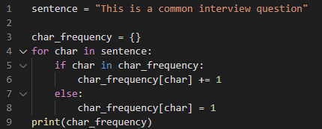

this output is a little bit unreadable, so I'm going to show you a trick to make it more readable.

Slide 5

We have a module called Pretty Printing
width, that determines the number of characters on each line. If this output doesn't fit, this function will add a line break.

Slide 6
So now we have all the information to solve this problem. The next step is to sort this dictionary by the frequency of characters. However, as I told you before, dictionaries like sets are unordered collections, We cannot sort them. We can only sort lists.
So we need to pull out the items in this dictionary and put them in a list for sorting.
So basically we need to take out each key value pair, convert it to a tuple and then put it in a list.
we'll end up with a list of tuples that we can easily sort

Slide 7
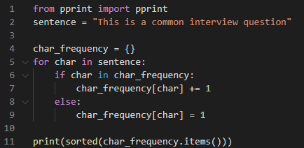

sorted function. Earlier You learn that this function takes
As the iterable, I'm going to pass char_frequency dot items.
Earlier you learn that this method returns all the key value pairs as tuples.

Slide 8
We get a list of tuples, in each tuple we have two items:the first is the character and the second is the repetition or frequency.
But as you can see, this list is not sorted because by default this sorted function doesn't know how to sort these tuples. So earlier I told you that we can pass a second argument here key, we set this to a lambda, which is an anonymous function,this function takes the key value pair and returns the value, so that is key value of one, that is the frequency of each character. We're going to use that for sorting.

Slide 9
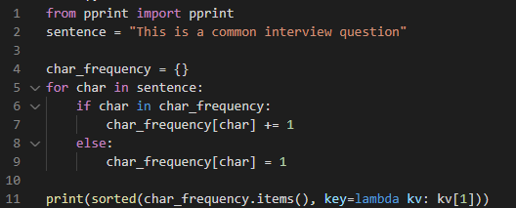
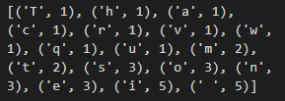

Slide 10
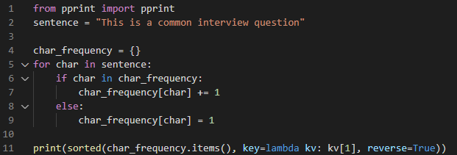
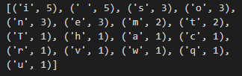
we need to reverse the sorting

Slide 11
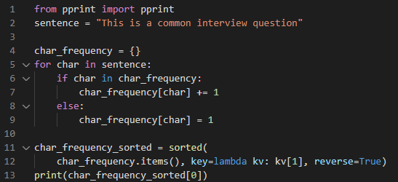

Slide 12
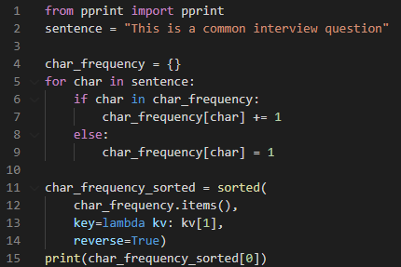
pepe8 recommends a maximum of 80 characters on one line. so if you have a line that is too long, it's better to break it down into multiple lines,this makes your code more readable
So here I'm going to list each argument on a new line

